Slide 1
Algorithms with Python
Course Introduction
SoftUni Team
Technical Trainers
Software University
https://about.softuni.bg

Slide 2
Table of Contents
Course Objectives
Exam
Training and Team
Course Organization
Course Infrastructure
Homework
Evaluation Criteria

Slide 3












SoftUni Diamond Partners

Slide 4


Educational Partners

Slide 5

Course Objectives

Slide 6
Course Objectives
Working with recursion and backtracking
Solving combinatorial problems
Searching, sorting and Greedy algorithms
Graph theory representation, traversal and shortest paths
Dynamic programming
Understanding solving techniques and choosing between multiple solutions

Slide 7
Practical Programming Exam
Exam
3 practical problems – 4 hours
Recursion and backtracking
Combinatorial problem
Searching, sorting and Greedy
Graph theory
Dynamic programming
Everything included in the course

Slide 8
Theoretical Exam
You will have 15 minutes once you enter
10 questions with:
Multiple choice with only one correct answers
English
Automated quiz system
Available online at the day and time of the practical exam
You can submit your answers just once

Slide 9

The Team

Slide 10
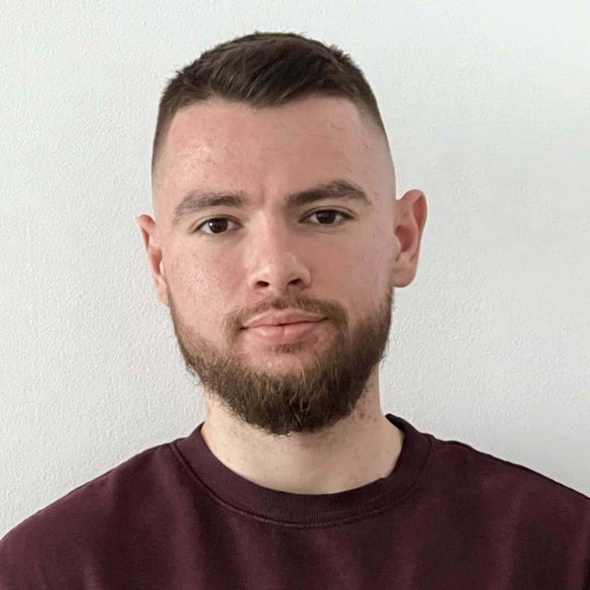
Atanas Atanasov
Software Engineer at Nexo
World's leading regulated digital assets institution
Created in Bulgaria
Technical Trainer at SoftUni
200+ training sessions for 4 years
Interested in the vast world of algorithms
Interested in the blockchain development
10

Slide 11

Course Organization

Slide 12
Course Timeline
04-Jul-2022
13-Aug-2022
20-Aug-2022
Algorithms with Python
7 weeks * 2 times / week
6 credits
Start: 04-Jul-2022
Exam: 13-Aug-2022
Retake: 20-Aug-2022
Lections are recorded
Recordings will be available at 10:00 on the scheduled day
There is one Live lection on 4th August from 18:30 to 21:30 – Exam Preparation + Q & A

Slide 13

Homework Assignments & Exercises
Your homework:
Lesson days → slides + live demos + exercises + tests
How to submit your homework?
Practical problems submitted in the judge system to 12th August
Quick tests
Do your homework when it's due
Assignments pile up quickly

Slide 14


Scoring System for the Course
Theoretical Exam 5%
Practical Exam 95%
Bonus Homework 5 %
Evaluation

Slide 15



Course Web Site, Forum and FB Group
Official web site:
Official discussion forum:
Official Facebook group:
https://softuni.bg/trainings/3817/algorithms-with-python-july-2022
https://softuni.bg/forum
https://www.facebook.com/groups/AlgorithmswithPythonJuly2022

Slide 16
Questions?

Slide 17

License
This course (slides, examples, demos, exercises, homework, documents, videos and other assets) is copyrighted content
Unauthorized copy, reproduction or use is illegal
© SoftUni – https://about.softuni.bg/
© Software University – https://softuni.bg
Notes:
17

Slide 18
Trainings @ Software University (SoftUni)
Software University – High-Quality Education, Profession and Job for Software Developers
softuni.bg, about.softuni.bg
Software University Foundation
softuni.foundation
Software University @ Facebook
facebook.com/SoftwareUniversity
Software University Forums
forum.softuni.bg
Notes:
18

